Slide 1

Kubernetes Hackfest Building Cloudy Applications
Jungho Kim Vikram Singh

Slide 2
Agenda
Time | Activity
8:00AM - 8:30AM | REGISTRATION
8:30AM – 9:00AM | BREAKFAST
9:00AM – 10:30AM | Kubernetes Architecture and Core Concepts
10:30AM – 10:45AM | BREAK
10:45AM – 12:00 | Hackfest Challenges
12:30 – 1:15PM | LUNCH
12:45PM – 2:00PM | Deploying/Reverse-Engineering the Todo Application
2:00PM – 2:45PM | Advanced K8S topics (RBAC, Ingress, Helm)
2:45PM – 3:00PM | BREAK
3:00PM – 4:15PM | Hackfest Challenges
4:15PM – 4:30PM | End of Day Summary & Prizes!!

Slide 3
Hackfest Approach
Goal is to maximize hands-on time
Introduce a series of topics then break for “Challenges”
Not step-by-step guided labs.
You will be thrown into the deep end but we are here to help!
Code samples available
Advanced scenarios possible
How to get help...
Kubernetes API Reference: https://v1-8.docs.kubernetes.io/docs/api-reference/v1.8/
kubectl explain e.g. kubectl explain pods.spec, kubectl explain pods.spec.containers...
Ask us :-)

Slide 4
Objective By End of Day
You have hands-on exposure deploying a micro-service based application to K8S
You have a base understanding of K8S architecture
You have a base understanding of core K8S concepts and resources
You have a base understanding of K8S tooling
You are excited about K8S and how it can change how you build enterprise solutions using open-source technologies on Azure!!

Slide 5
What we won’t cover
K8S is a large topic, we can’t cover everything in one day
We won’t cover:
How to secure your cluster (e.g PodSecurityPolicy, NetworkPolicy, etc)
Best-practices for building lean, secure Docker images
Best-practices when building native K8S apps
Different cluster provisioning options e.g. acs-engine, kubeadm, kubespray
CNI (Container Network Interface) and different options to meet K8S network requirements
Advanced storage management scenarios (e.g. StorageClasses)
Advanced scheduling scenarios (e.g taints/tolerations, affinity/anti-affinity)
Auto-scaling cluster nodes on Azure
We do have a 2-Day Kubernetes Bootcamp for that!!

Slide 6
Why Modernize Apps?

Slide 7
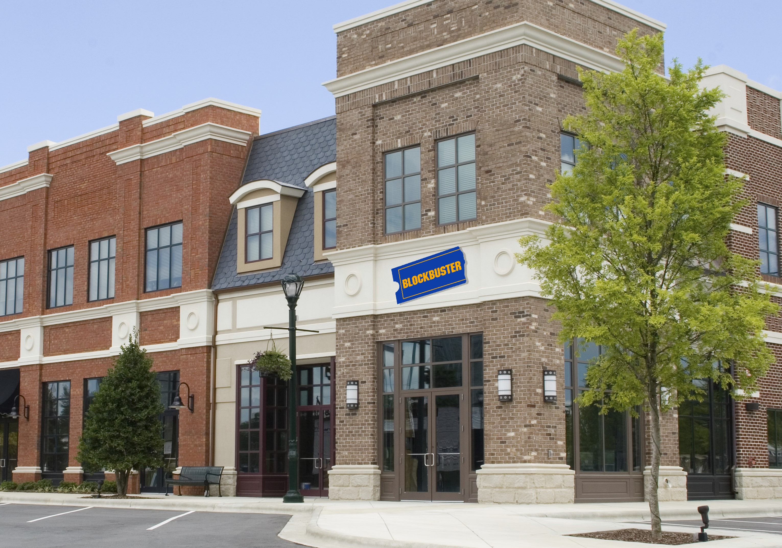








Slide 8
Our world is changing
Past
Long application cycles
Monolithic apps
Servers and VMs
Less data
Distinct infrastructure and operations teams
Today
Rapid innovation
Loosely-coupled apps and microservices
Serverless
Big Data
Service-focused DevOps teams
Servers
Services

Slide 9
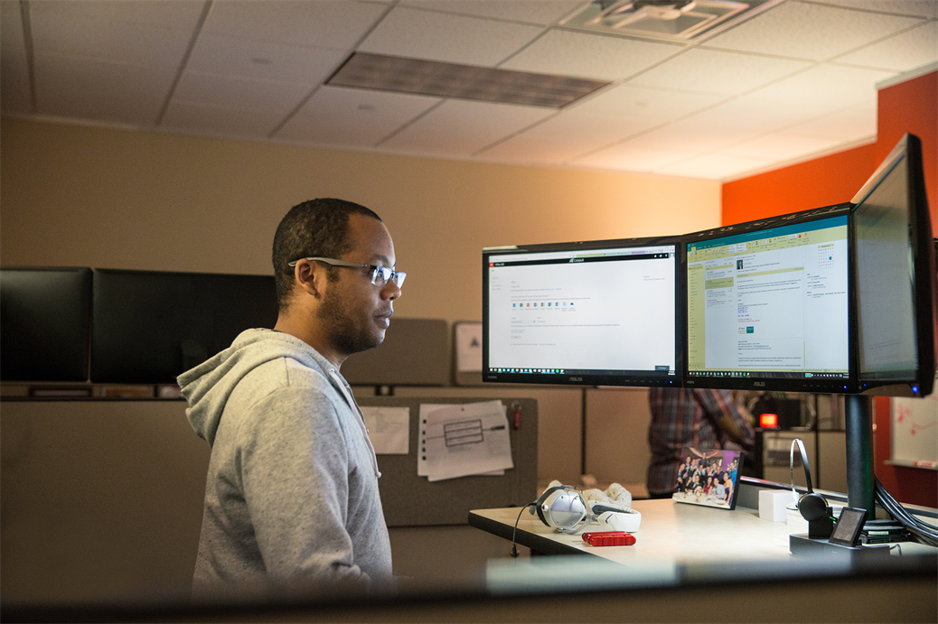
Where do developers spend time…
Maintaining existing applications
“Fixing” existing applications
Adding features to existing applications
Fixing the feature someone else added to the existing applications
Building a new application
(maybe … if there’s time)

Slide 10

Where do application admins spend time…
Maintaining existing applications
Re-deploying new versions
of existing applications
Diagnosing issues with
existing applications
Troubleshooting issues from feature additions to the existing applications
Deploying a new application

Slide 11

Help customers free resources and work more efficiently by modernizing traditional applications

Slide 12


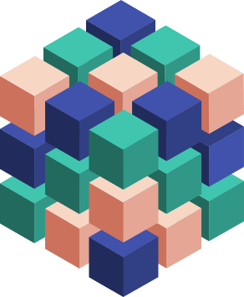
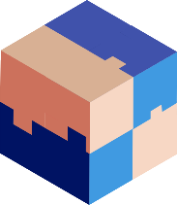



Ways to Modernize Applications
Lift & Shift
Modernize
Decompose
Transformed
Traditional application
Hosted as guest executables or containers in Kubernetes
Modernization by adding new microservices
Innovate by decomposing application into microservices
Transformed into microservices or new greenfield application
…You can stop at any stage

Slide 13


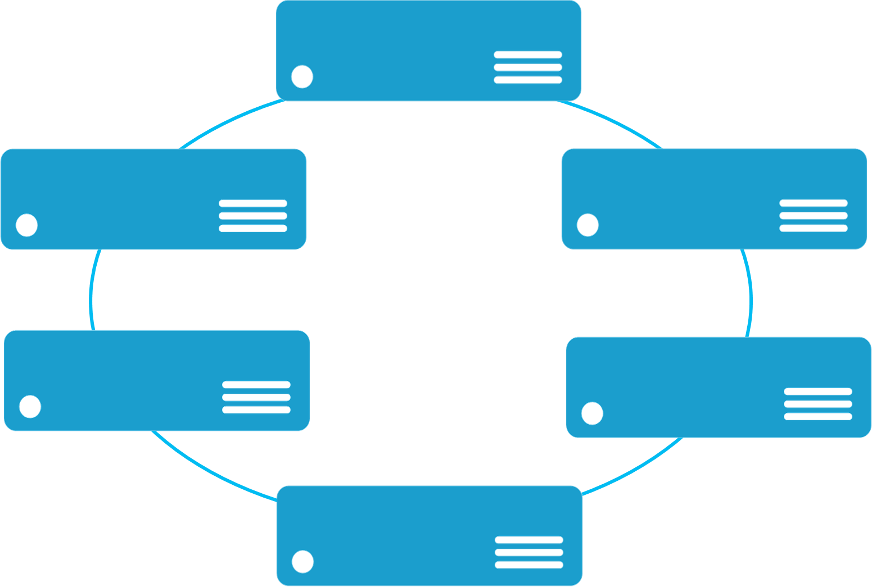


Monolithic application approach
Microservices application approach
A monolithic application has most of its functionality within a single process that is commonly componentized with libraries.
Monolith
A microservice application separates functionality into separate smaller services.
Microservices
Scales by cloning the app on multiple servers/VMs/Containers
Scales out by deploying each service independently creating instances of these services across servers/VMs/containers
State

Slide 14
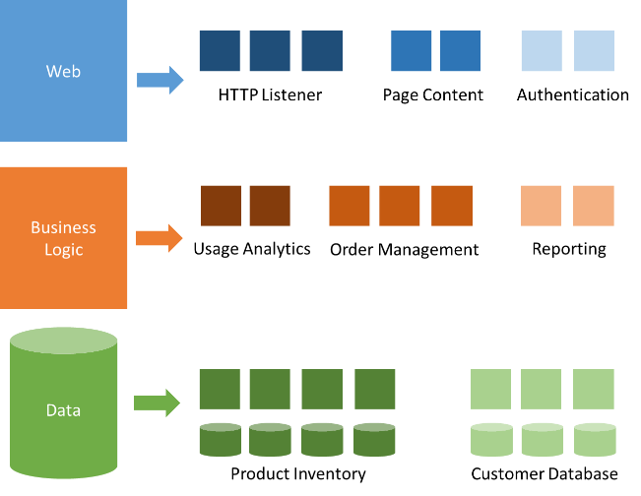
Modernization with microservices
Individually built and deployed
Small, independent services
Integrate using published API
Fine-grained, loosely coupled

Slide 15
Microservice architecture benefits
Scale Independently
Different Technology Stacks
Photo Share Service
Thumbnail Service
Photo Share Service node.js
Thumbnail Service .NET
Photo Share Service
Thumbnail Service
Photo Share Service
Thumbnail Service
Photo Share Service
Conflicting Dependencies
Independent Deployments
Photo Share Service
Photo Share Service V1
Thumbnail Service V1
SharedLib-v1
Thumbnail
Thumbnail Service V2
SharedLib-v7
Photo Share Service
Thumbnail Service
SharedLib-v1
SharedLib-v7

Slide 16
Microservices Benefits
Independent deployments
Enables continuous delivery
No downtime upgrades
Improved scale and resource utilization per service
Fault isolation
Security isolation
Services can be distributed across multiple servers or environments
Multiple languages / diversity
Smaller, focused teams
Code can be organized around business capabilities
Autonomous developer teams

Slide 17
Microservices – The Hard Part
Deployment is complex
Testing is difficult
Debugging is difficult
Monitoring/Logging is difficult
New service versions must support old/new API contracts
Distributed databases make transactions hard
Cluster and orchestration tools overhead
Distributed services adds more network communication
Increased network hops
Requires failure/recovery code
Need service discovery solution
Advanced DevOps capability: short-term pain for long-term gain

Slide 18
“Distributed apps are sufficiently complicated that they need to be flown by the instruments”

Slide 19
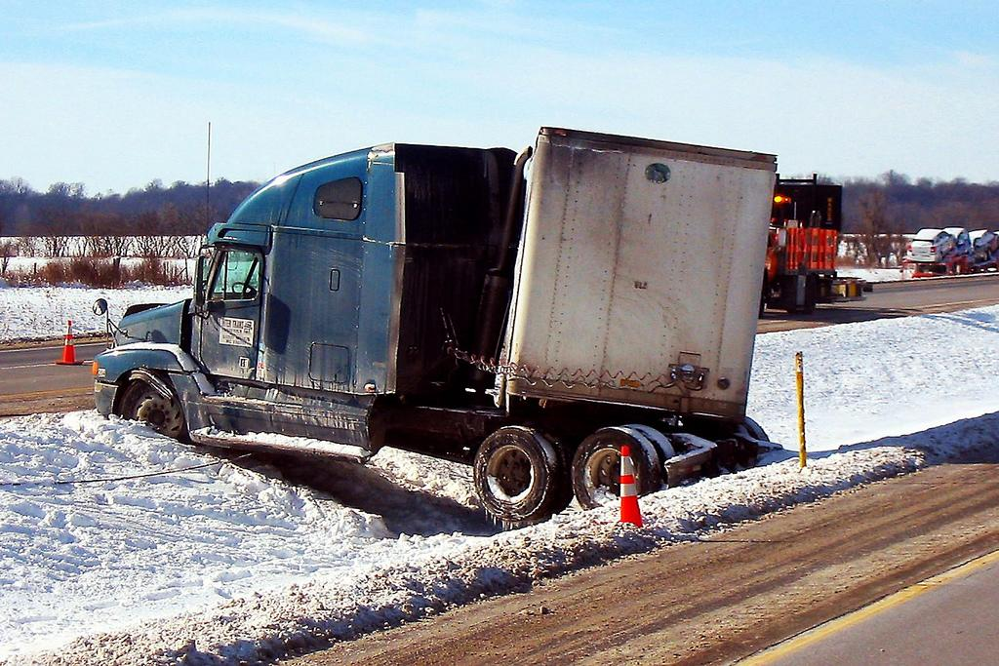
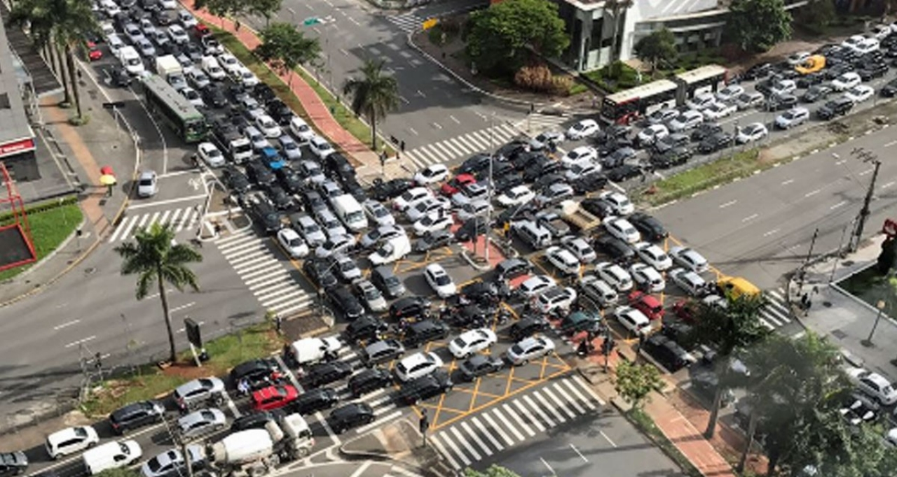

Slide 20
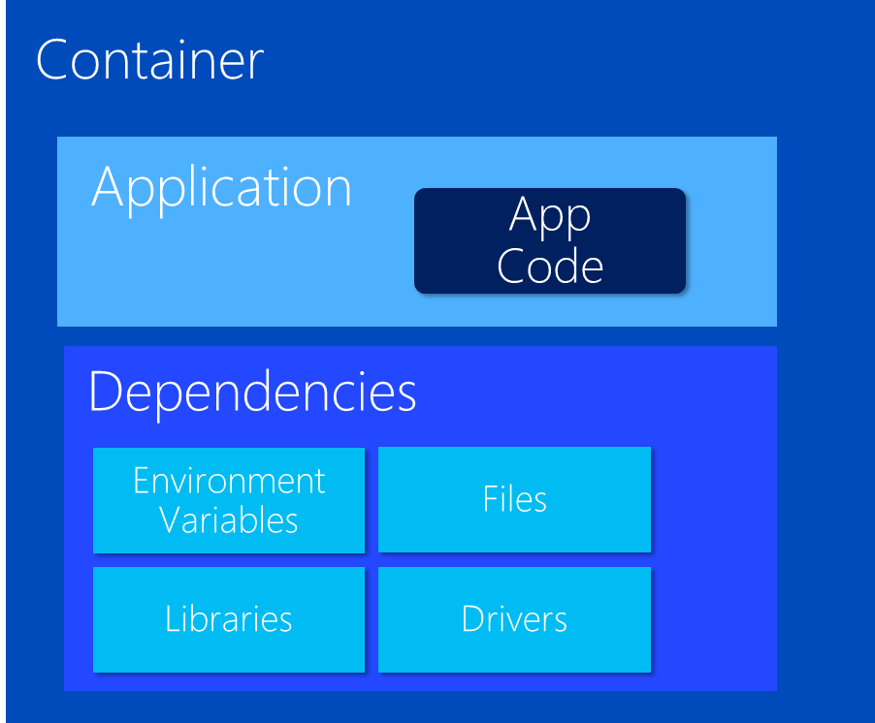
VM Host
VM Host
VM Host
VM Host
But things get
complicated quickly

Slide 21
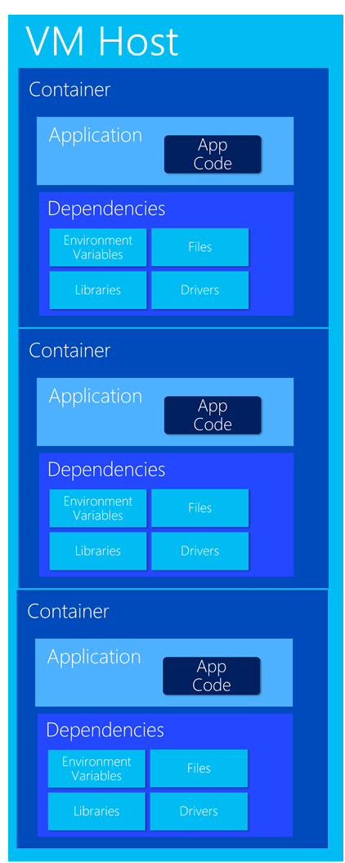
Very Quickly

Slide 22
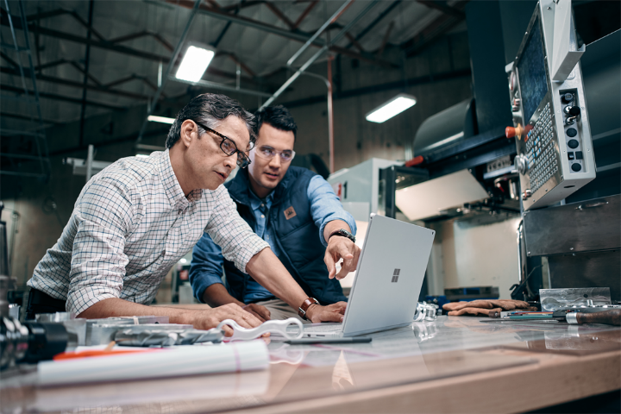
What do cluster orchestrators do?
Provision
Security
Deploy (app / container)
Storage
Health Monitoring
Networking
Scaling
Service Discovery
Monitoring / Logging
Registry

Slide 23
Container Management at Scale
Cluster Management: deploy and manage cluster resources
Scheduling: where containers run
Lifecycle & Health: keep containers running despite failure
Naming & Discovery: where are my containers
Load Balancing: evenly distribute traffic
Scaling: make sets of containers elastic in number
Image repository: centralized, secure Docker container images
Continuous Delivery: CI/CD pipeline and workflow
Logging & Monitoring: track what’s happening in containers and cluster
Storage volumes: persistent data for containers

Slide 24
Orchestrator Ecosystem (Constantly Changing)
Cloud services
Azure Container Services (AKS, ACS)
Azure Service Fabric (ASF)
Amazon EC2 Container Services (ECS)
Google Kubernetes Engine (GKE)
Heroku
Tutum
Complete platforms
Kubernetes
Red Hat OpenShift (OCP)
Cloud Foundry
Mesosphere (Marathon)
Enterprise DC/OS
Docker Enterprise
Rancher
Low-level
Docker Swarm
CoreOS Fleet

Slide 25
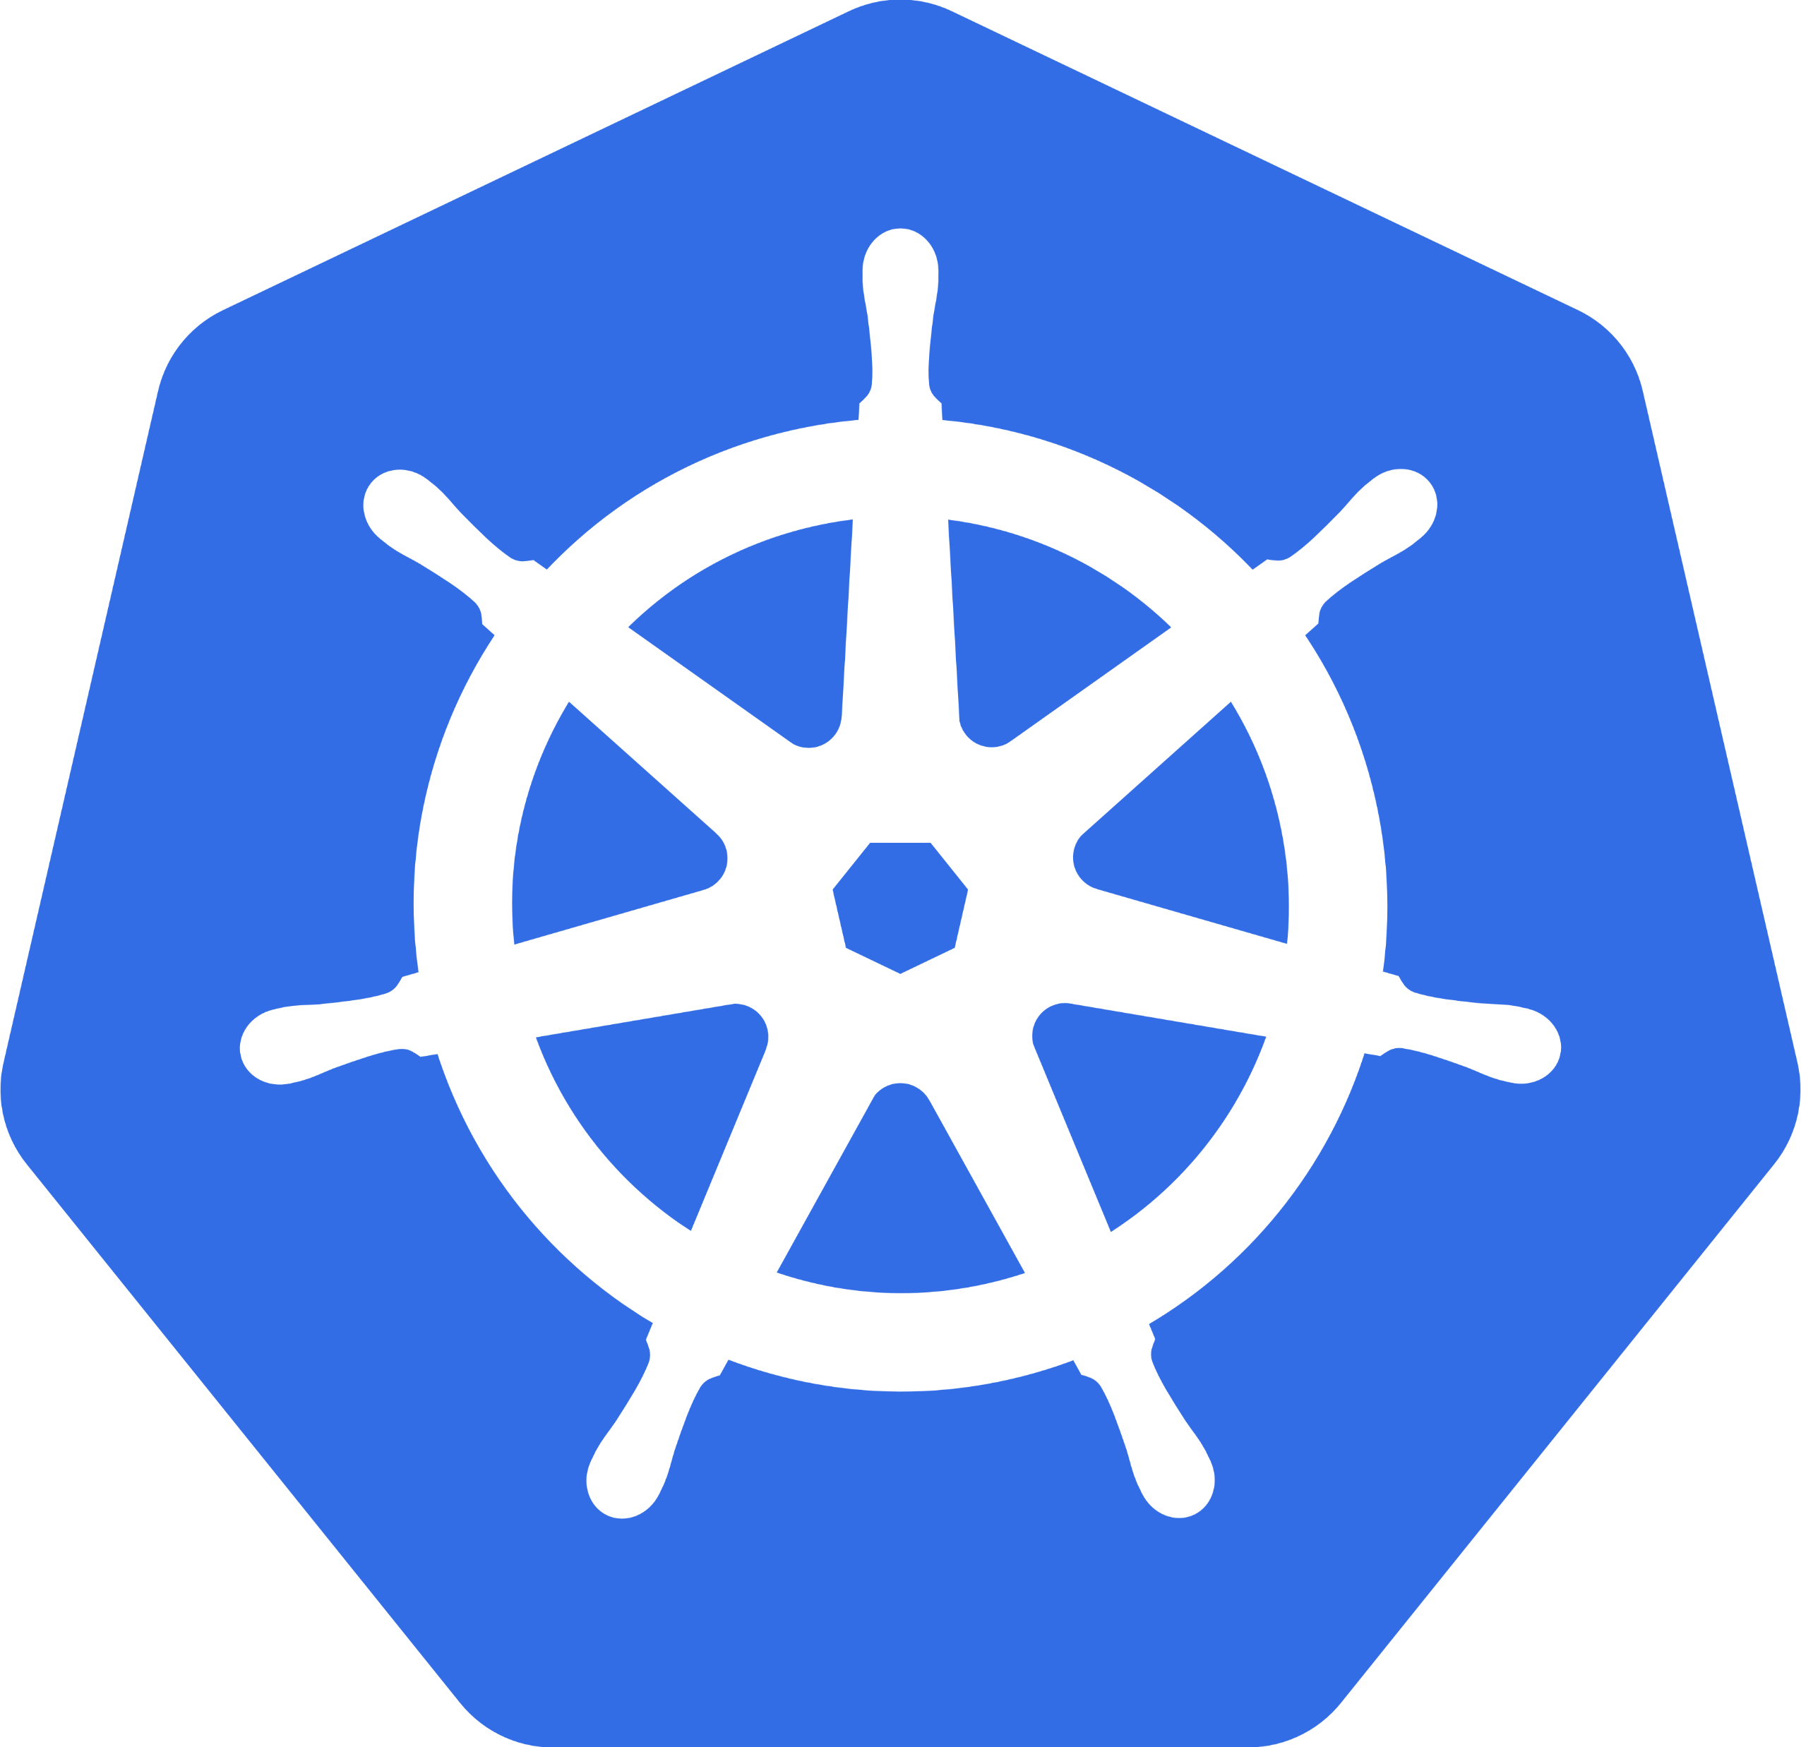
Why Kubernetes (K8s)?
Industry Momentum
It’s Microsoft’s Direction
It’s Docker’s Direction
It’s OCP’s Direction
It’s Cloud Foundry’s Direction
Brendan Burns
One of the Founders of K8s
Now works at MS heading up Container Strategies

Slide 26
What is Kubernetes?
History
Google open sourced borg. Google still actively involved, but less so every day
Schedules and runs application containers across a cluster of machines
Kubernetes v1.0 released on July 21, 2015. Joe Beda, Brendan Burns, & Craig McLuckie
Over 1,700 authors
Key features
Declarative infrastructure
Self-healing
Horizontal scaling
Automated rollouts and rollbacks
Service discovery and load balancing
Automatic binpacking
Storage orchestration
Secret and configuration management
Not a PaaS platform

Slide 27
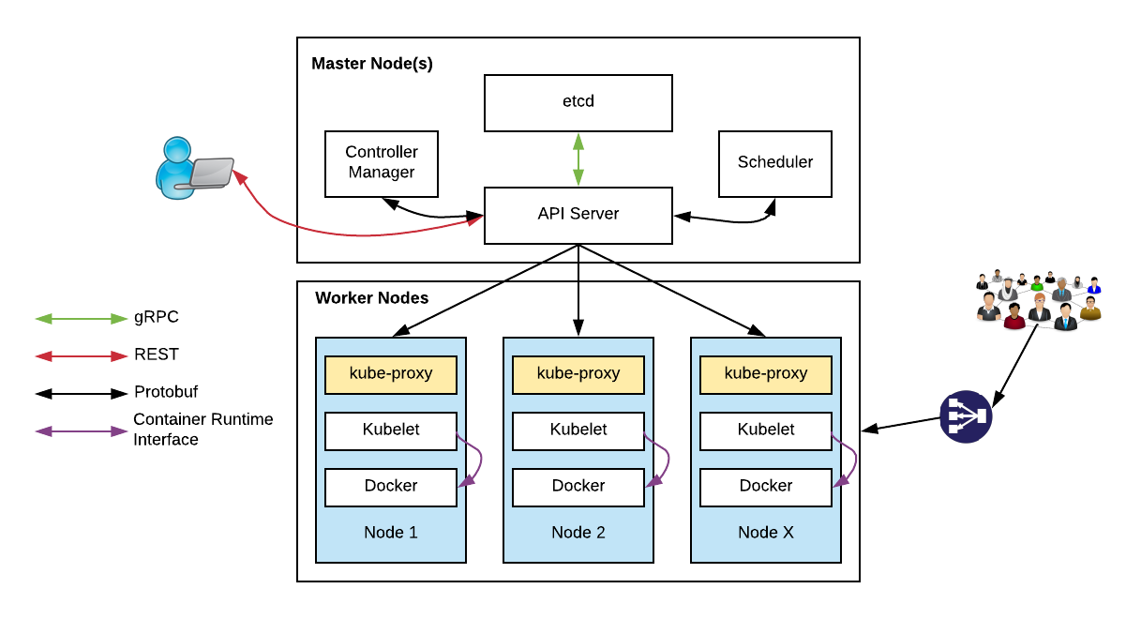
Kubernetes Architecture

Slide 28
Kubernetes Architecture Components
api-server
etcd
master components
controller-manager
scheduler
kubelet
kube-proxy
node components
container runtime (e.g. Docker, rkt)
dns

Slide 29
Master Components
api-server: Front-end control plane. Exposes API
etcd: Cluster database. Distributed, highly available
controller-manager. Runs controllers, eg. replication controller, deployment controller, and more
scheduler: assigns pods to nodes
Add-ons
DNS
Heapster. enables monitoring and performance analysis
Dashboard
Logging
Notes:
Api-server
Many different flags or switches to configure
REST interface
Etcd
Distributed, highly available key store
Written and maintained by CoreOS
Raft consensus algorithm
watches, keys, values
etcd3 standard beginning with Kubernetes 1.6
Scheduler: “Policy-rich, topology-aware, workload-specific function that significantly impacts availability, performance, and capacity”

Slide 30
Worker Node Components
kubelet:
Primary node agent
Watches and runs assigned pods
Executes health probes and reports status
Also key to “self-hosted” deployment of K8S where K8S is used to host K8S!!
kube-proxy: enables network services
docker: container engine (rkt supported experimentally)

Slide 31
kubectl: CLI to run commands against a Kubernetes cluster
Swiss Army Knife: run deployments, exec into containers, view logs, etc.
Syntax largely the same as docker
Pronounced “koob sea tee el”…
Or “koob cuddle”
Notes:
Borg: The first unified container-management system developed at Google
It was built to manage both long-running services and batch jobs

Slide 32
Kubernetes Resources
Pod
Deployment
Describes the “desired state” of your system
Components such as Controllers, the Scheduler, API Server, kubelet work together to put the system into the “desired state”
etcd stores this state
Service
ReplicaSet
Ingress
DaemonSet
Namespace
Job, CronJob
Secret, ConfigMap
and more!

Slide 33
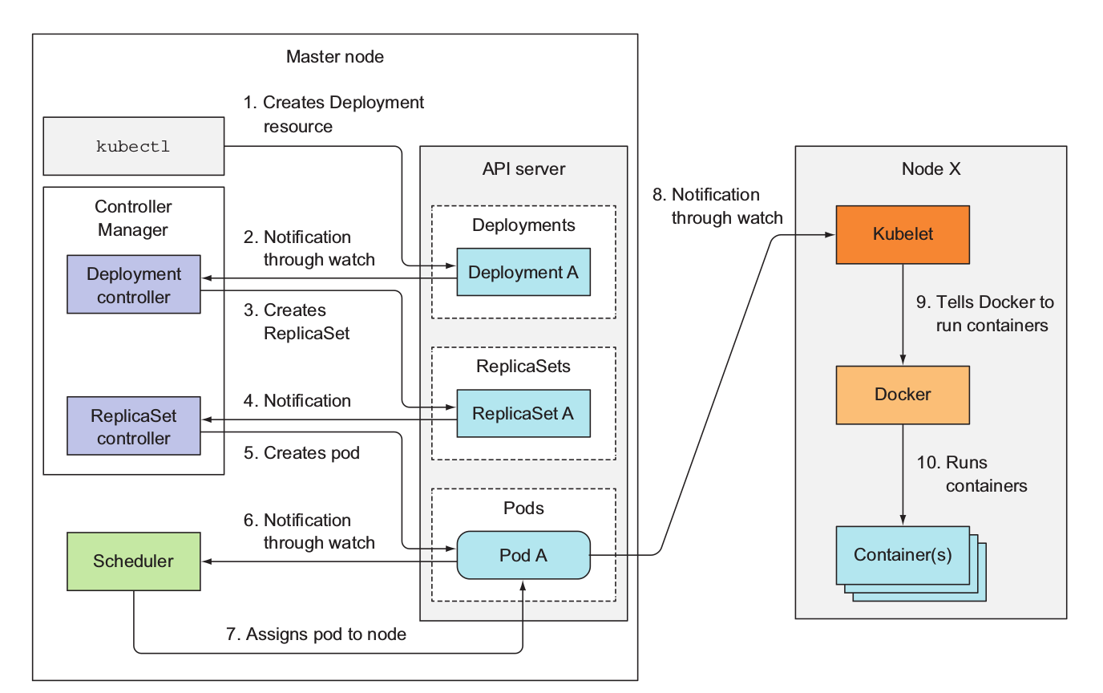
Deployment Events
From “Kubernetes in Action” by Manning

Slide 34
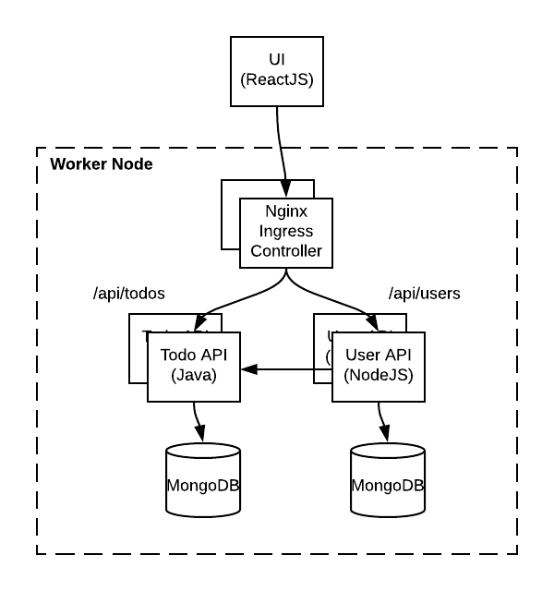
Todo Application
Simple Micro-service based application
ReactJS UI
Java Springboot TodoItem API
NodeJS User API
MongoDB for the database
Supports OpenID Connect/OAuth2 with Azure AD

Slide 35
DevOps & CI / CD

Slide 36
DevOps Practices Arrive
Developers: Test, Build, Code, Plan
Operations: Monitor, Release, Deploy, Operate
DevOps Features
Speed of application delivery/updates
Faster time to value
Repeatable/consistent
Automated testing
Traceability of process
Applying developer patterns to infrastructure
Infrastructure as code
Ops teams embracing source control
Centralized monitoring, logging, debugging
CI / CD – key aspect of quality DevOps

Slide 37
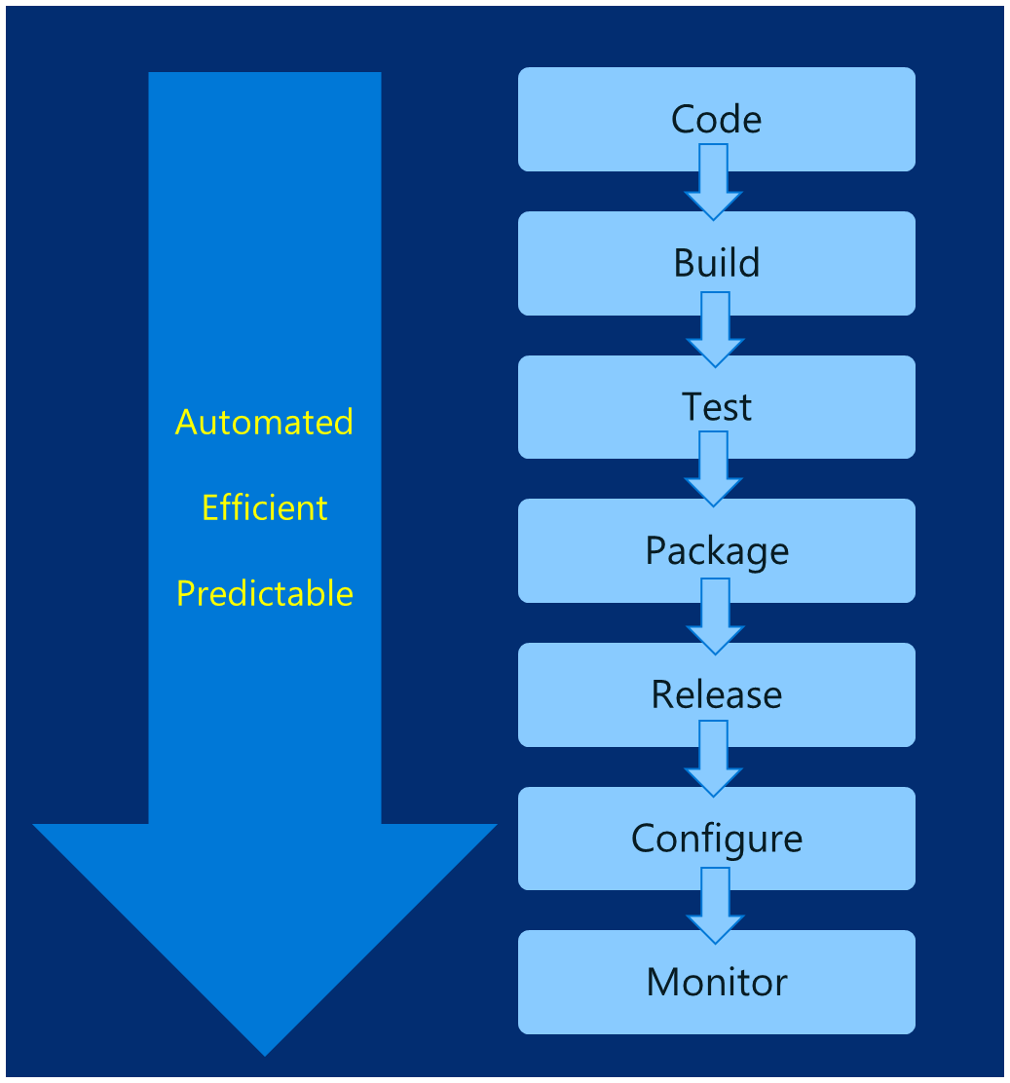
DevOps – Why you care
Deploy 200 times more frequently
Go from code check-in to production 2,555 times faster
Recover from failure 24 times faster
Spent 50% less time remediating security challenges
Spent 22% less time on unplanned work
2.2 times more likely to believe their places a great place to work
Source: https://puppet.com/resources/white-paper/2016-state-of-devops-report

Slide 38
Common Toolsets
Jenkins
Visual Studio Team Services
Spinnaker and Netflix OSS
Travis
TeamCity
CircleCI
Additional utilities: code quality scanning, security, collaboration, etc.

Slide 39
Helm: Kubernetes Package Manager

Slide 40
Birth of Helm
On October 15th, 2015
Hackathon project at company offsite
Could we take the ideas behind npm and Homebrew and build something for deploying apps into Kubernetes?
Installation tool for Deis Workflow
Announced at the first KubeCon in San Francisco 2015

Slide 41
Helm Charts
Application definition
Consists of:
Metadata
Kubernetes resource definitions
Configuration
Documentation
Stored in chart repository
Any HTTP server that can house YAML/tar files (Azure, GitHub pages, etc.)
Public repo with community supported charts (eg – Jenkins, Mongo, etc.)
Helm (CLI) + Tiller (server side)
Release: Instance of chart + values -> Kubernetes

Slide 43
Chart structure
Charts have structure
Set of conventions, including file and directory names
Charts can be packaged into tarballs for distribution

Slide 44
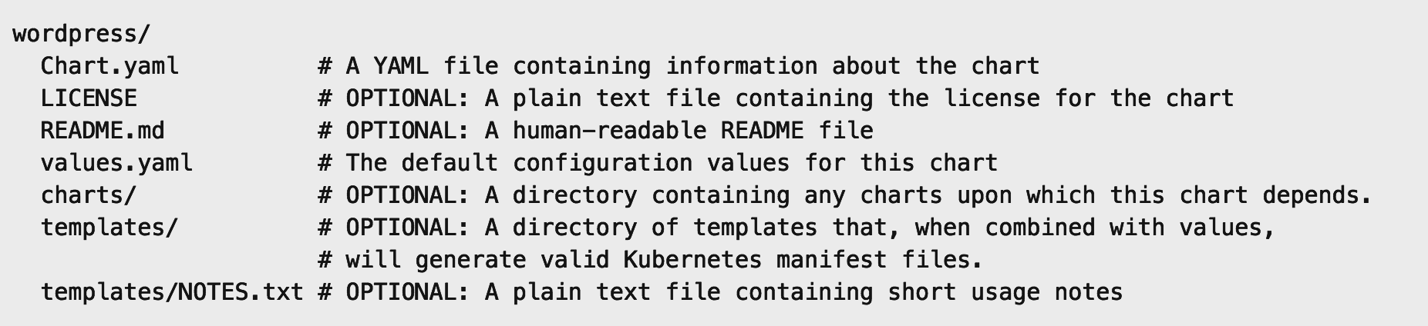
Chart structure
Layout
Helm expects a strict chart structure

Slide 45
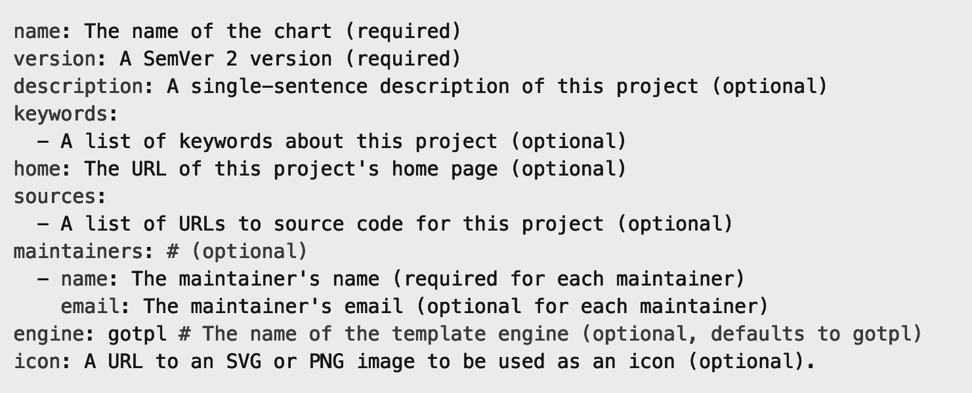
Chart.yaml

Slide 46
Helm values.yaml
The knobs and dials:
A values.yaml file provided with the chart that contains default values
Use -f to provide your own values overrides
Use --set to override individual values

Slide 47
Helm Templates
Built on Go’s template language w/addition of 50 or so add-on template functions
Almost anything goes! ;-)
Also useful in generating random values (e.g. passwords)
Provides flow control (if/else, with, range, etc)
Named templates (partials)

Slide 48
Application Health and Readiness
Kubelets on workers use liveness and readiness probes to know when to restart a container or start directing traffic
Liveness check: when to restart
Readiness check: when to forward Service traffic to a pod
Notes:
Look at liveness
Look at readiness

Slide 49
Monitoring: What indicators matter in Kubernetes
Cluster health: total number of nodes, pods, etc
Node health: available compute resources, health
Application health
Tooling Examples
Datadog
Prometheus
Cloud-specific: OMS (Azure), CloudWatch (AWS)

Slide 50
Logging
Pod logs: applications must log to standard out!
Cluster-wide event logs
Logging forwarder solutions
fluentd
logstash
Log indexers
OMS Log Analytics
Splunk
ELK stack

Slide 51
Appendix
Add location to code repo here

Slide 52
Docker, Docker, Docker
Containers have been around for many years
Linux kernel: cgroups, namespaces
Docker Inc. did not invent them
They created open source software to build and manage containers
Docker makes containers easy
Super easy. Fast learning curve
Docker is a container format and a set of tools
Docker CLI, Docker Engine, Docker Swarm, Docker Compose, Docker Machine

Slide 53
What is a container?
Slice up the OS to run multiple apps on a single VM
Every container has an isolated view and gets
it’s own file system
it’s own PID0 and eth0 network interface
Container and apps share lifecycle
Shared kernel, very fast start-up, and repeatable execution
Cannot mix OS
VM/Host
Container: App-A:v1
Container: App-B:v3
Container: App-A:v2
App-A v1
App-B v3
App-A v2
Lib-L v2
Lib-L v3
Lib-L v3
Lib-M v2
Runtime v5
Runtime v7
Runtime v6
Notes:
- Encapsulation of Dependencies (Environment Variables, Files, Libraries and Drivers)

Slide 54

How Containers Work
Containers
Windows Server containers No different from Linux containers
= Operating system virtualization
Container
Container
Container
Container
Container
Container
Application
OS
Hardware
Windows Server
Traditional virtual machines = hardware virtualization
Hyper-V containers Isolation plus performance
Application
VM
VM
VM
Container
Container
Container
OS
Hardware
WS
WS
WS
Hyper-V

Slide 55
Docker vs VMs

Slide 56
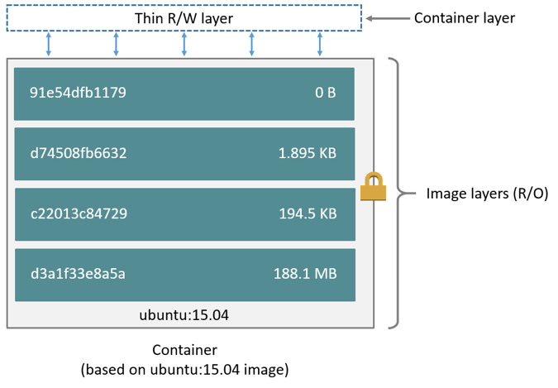
Docker Container Anatomy
Image source: https://docs.docker.com/engine/userguide/storagedriver/imagesandcontainers/#images-and-layers

Slide 57
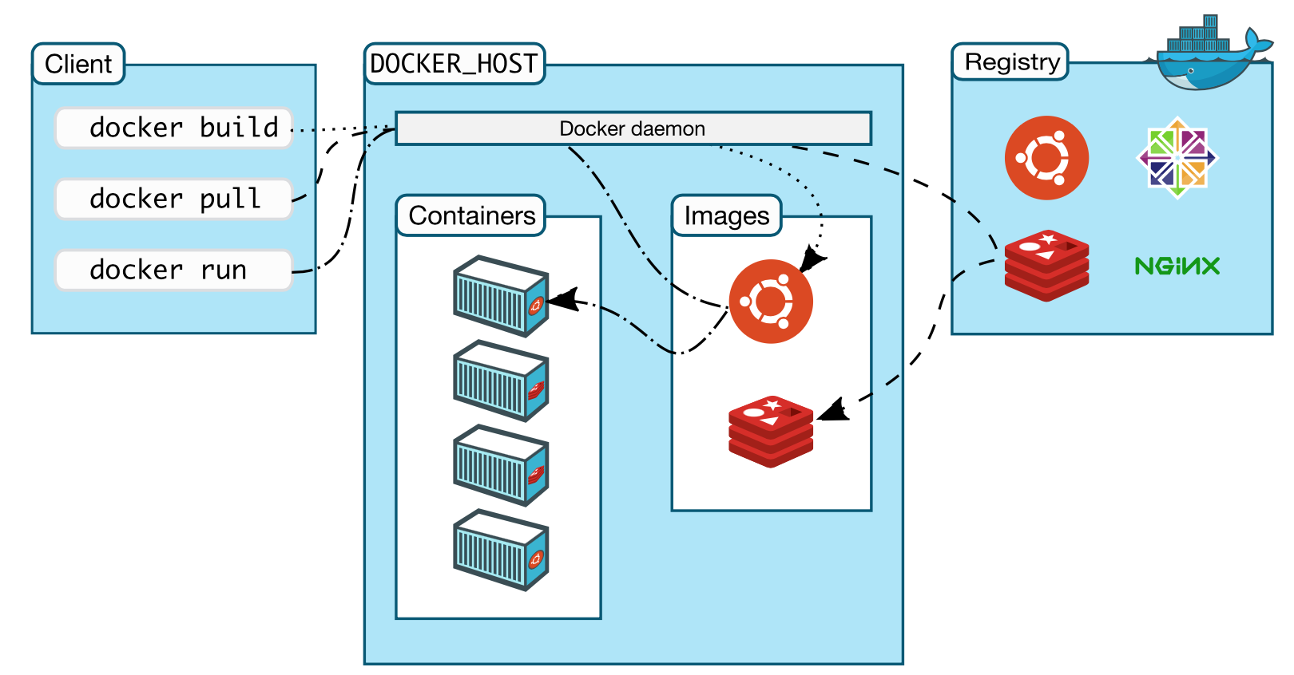
Docker architecture

Slide 58
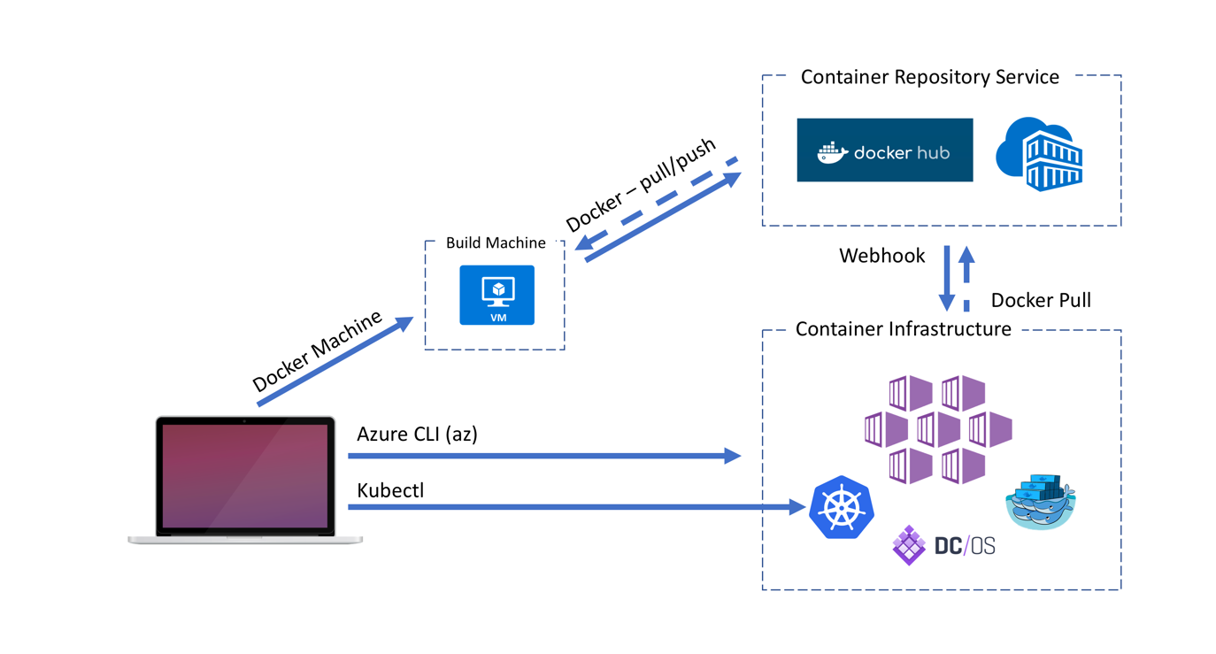
Docker architecture

Slide 59
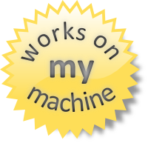
Why containers?
Repeatable execution
immutable environment
reusable and portable code (“Build, Ship, and Run”)
Consistency across development, test, & production
Fast & agile app deployment; instant startup
Cloud portability
Density, partitioning, scale
Diverse developer framework support
Microservices

Slide 61
12-Factor Apps
http://12factor.net

Slide 62
12-Factor Apps (1-5)
Single root repo; don’t share code with another app
Deploy dependent libs with app
No config in code; read from environment vars
Handle unresponsive app dependencies robustly
Strictly separate build, release, & run steps
Build: Builds a version of the code repo & gathers dependencies
Release: Combines build with config ReleaseId (immutable)
Run: Runs app in execution environment
Notes:
Single root repo; don’t share code with another app
Deploy dependent libs with app
No config in code; read from environment vars
Handle unresponsive app dependencies robustly
Strictly separate build, release, & run steps
Build: Builds a version of the code repo & gathers dependencies
Release: Combines build with config → ReleaseId (immutable)
Run: Runs app in execution environment

Slide 63
12-Factor Apps (6-12)
App executes as 1+ stateless process & shares nothing
App listens on ports; avoid using (web) host
Use processes for isolation; multiple for concurrency
Processes can crash/be killed quickly & start fast
Keep dev, staging, & prod environments similar
Log to stdout (dev=console; prod=file & archived)
Deploy & run admin tasks (scripts) as processes
Notes:
App executes as 1+ stateless process & shares nothing
App listens on ports; avoid using (web) host
Use processes for isolation; multiple for concurrency
Processes can crash/be killed quickly & start fast
Keep dev, staging, & prod environments similar
Log to stdout (dev=console; prod=file & archived)
Deploy & run admin tasks (scripts) as processes

Slide 64

Questions?

